Slide 1
Bachelor's degree thesis on the topic: «DISTRIBUTED SYSTEM OF CRYPTOGRAPHIC DATA PROTECTION BASED ON ELLIPTIC CURVES»
Moscow Aviation Institute (National Research University)
Institute No. 8 «Computer Science and Applied Mathematics»
Department No. 806 «Computational Mathematics and Programming»
Student of group MO-411B-19: Dmitry AlexandovichTrishin
Academic supervisor: Candidate of Physical and Mathematical Sciences, Associate Professor of MAI A.M. Romanenkov
Moscow – 2023

Slide 2
The relevance of the topic
The relevance of the topic of this work is associated with the increasing need for data protection on the Internet. In the modern world, most processes are carried out through computers and the Internet, and a large amount of confidential data is transmitted over the network. However, this also means that data can be stolen or compromised by malicious actors.

Slide 3
The aim and objectives of the work
The aim: to develop a mathematical source code library for working with elliptic curves and implementation of a distributed client-server application system.
Objectives:
Studying the theoretical material on elliptic curves over finite characteristic fields;
Writing a mathematical source code library for working with elliptic curves over finite characteristic fields;
Implementing symmetric and asymmetric encryption algorithms based on elliptic curves to create a hybrid cryptosystem;
Developing a client-server application with load balancing considerations that uses the developed cryptosystem.

Slide 4
Technology stack
Programming languages: C#
Frameworks: ASP.NET, .NET WPF, Open API
Libraries: Entity Framework Core, Swagger UI, Ocelot
Database: PostgreSQL

Slide 5
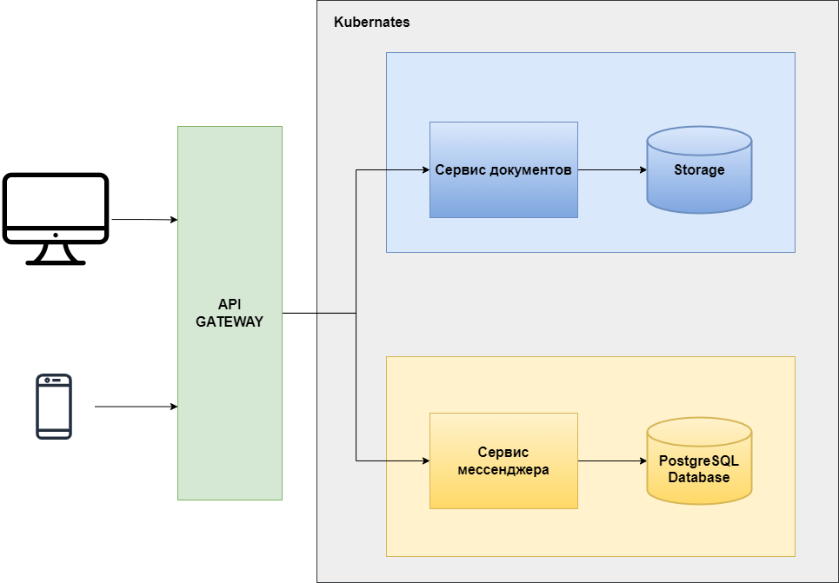
Model architecture, algorithm for solving the problem

Slide 6
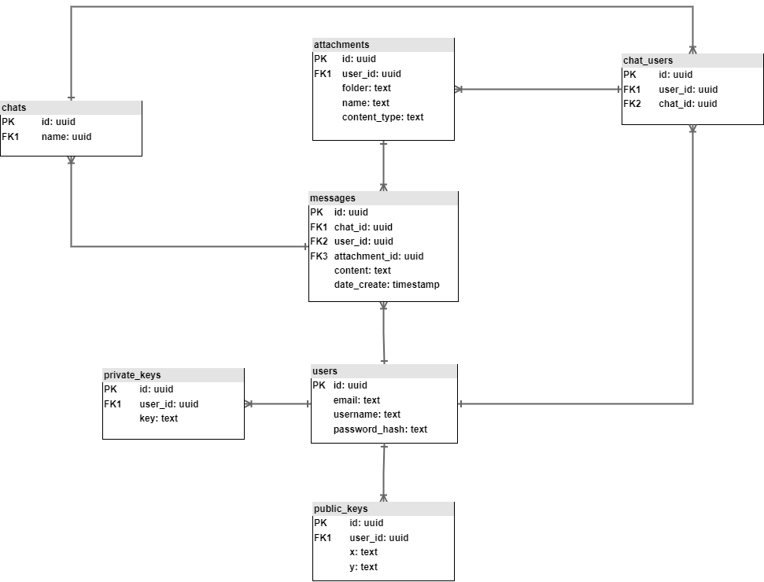
Model architecture, algorithm for solving the problem

Slide 7

Description of software development
QR code of the link where the code is posted:

Slide 8
Result
As a result, the following were developed:
A source code library for working with elliptic curves over finite fields
A distributed system consisting of a main REST API application, a database server, and a document storage server, using the developed cryptosystem to protect data
A PC application running on Windows OS, implementing online chat functionality.

